Slide 1

Project Title -Seasonal Agriculture Performance Analysis
Student Name: Shaik Awaz ali
College Name: Amrita Sai Institute of Science and Technology
AICTE STU ID:STU674a975918c331732941657

Slide 2

PROBLEM STATEMENT
Seasonal Variability: Farming outcomes vary across seasons due to changing rainfall, temperatures, soil moisture, and market dynamics.
Data Complexity: Raw agricultural datasets obscure key relationships between water allocation, pest risks, crop yield, and overall farm margins.
Objective: Analyze 4,000 multi-region farm records to identify seasonal performance patterns, evaluate resource efficiency, and recommend data-driven farming strategies.

Slide 3
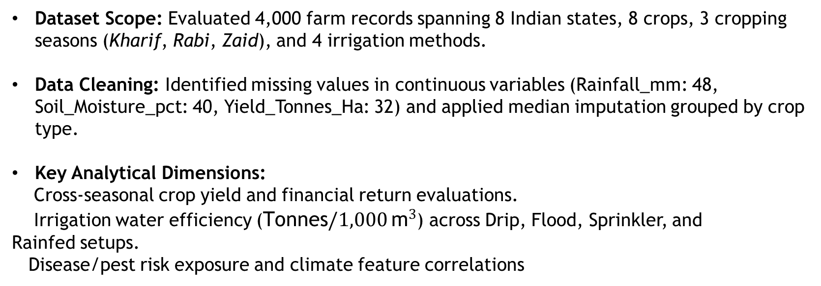
Project Description
Dataset Scope: Evaluated 4,000 farm records spanning 8 Indian states, 8 crops, 3 cropping seasons (Kharif, Rabi, Zaid), and 4 irrigation methods.
Data Cleaning: Identified missing values in continuous variables (Rainfall_mm: 48, Soil_Moisture_pct: 40, Yield_Tonnes_Ha: 32) and applied median imputation grouped by crop type.
Key Analytical Dimensions:
Cross-seasonal crop yield and financial return evaluations.
Irrigation water efficiency ($\text{Tonnes}/1,000 {\text{m}}^{3}$) across Drip, Flood, Sprinkler, and Rainfed setups.
Disease/pest risk exposure and climate feature correlations

Slide 4

WHO ARE THE END USERS?
Farmers & Local Agricultural Producers: Guidance on optimal crop selection per season, resource management, and profit optimization.
Agronomists & Farm Advisors: Empirical data on soil moisture retention, fertilizer responsiveness, and seasonal disease/pest thresholds.
Policy Makers & Government Officials: Insights for targeted irrigation subsidies (e.g., drip adoption), seasonal credit planning, and crop support pricing.
Agri-Tech Companies: Predictive models for input supply chain management and seasonal yield forecasting.

Slide 5

Technology Used
Language: Python 3.x
Data Manipulation & Analysis: Pandas, NumPy
Data Visualization: Matplotlib, Seaborn, Plotly Express
Development Environment: Jupyter Notebook
Version Control: GitHub

Slide 6
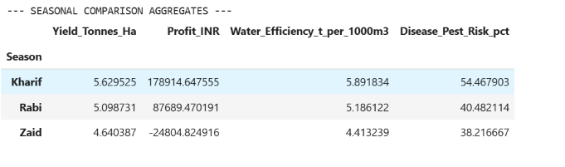
RESULTS
Seasonal Comparison
Kharif Season (Monsoon): Highest average crop yield (5.63 t/ha) and profit (₹178,914.65 / farm), accompanied by elevated disease/pest risk (54.47%) due to high rainfall and humidity.
Rabi Season (Winter): Stable yield (5.10 t/ha) and positive returns (₹87,689.47 / farm) with moderate pest risk (40.48%).
Zaid Season (Summer): Lowest average yield (4.64 t/ha) resulting in net operating losses (-₹24,804.82 / farm) due to heat stress and water scarcity.

Slide 7
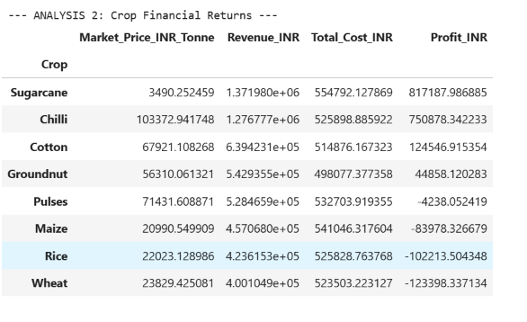
RESULTS
2. Crop Financial Performance
High-Value Cash Crops:
  Sugarcane: Highest volume output (119,685.97 total tonnes) with an average profit of ₹817,187.99 per farm.
  Chilli: High market realizations yielding ₹750,878.34 average profit per farm.
Low-Margin Food Grains:
  Staple grains operate at average net losses under standard pricing: Wheat (-₹123,398.34), Rice (-₹102,213.50), and Maize (-₹83,978.33)

Slide 8
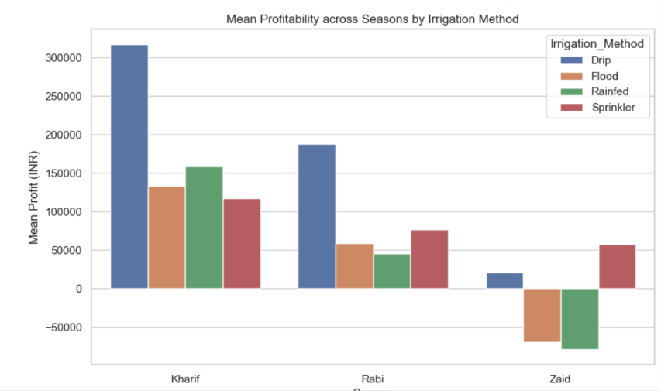
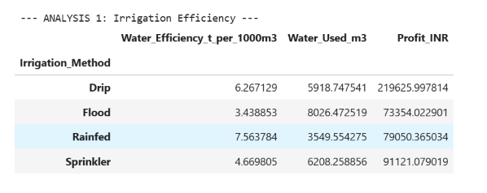
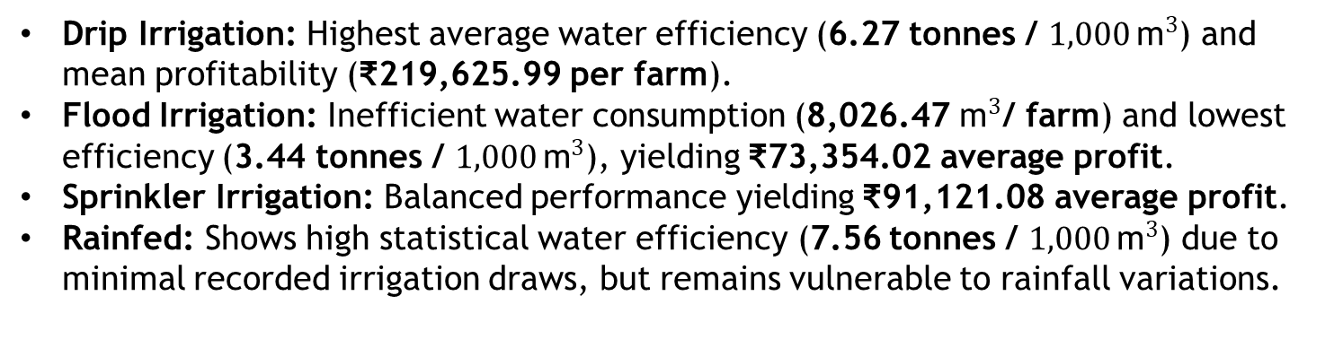
RESULTS
3. Irrigation Efficiency
Drip Irrigation: Highest average water efficiency (6.27 tonnes / $1,000 {\text{m}}^{3}$) and mean profitability (₹219,625.99 per farm).
Flood Irrigation: Inefficient water consumption (8,026.47 ${\text{m}}^{3}$/ farm) and lowest efficiency (3.44 tonnes / $1,000 {\text{m}}^{3}$), yielding ₹73,354.02 average profit.
Sprinkler Irrigation: Balanced performance yielding ₹91,121.08 average profit.
Rainfed: Shows high statistical water efficiency (7.56 tonnes / $1,000 {\text{m}}^{3}$) due to minimal recorded irrigation draws, but remains vulnerable to rainfall variations.

Slide 9
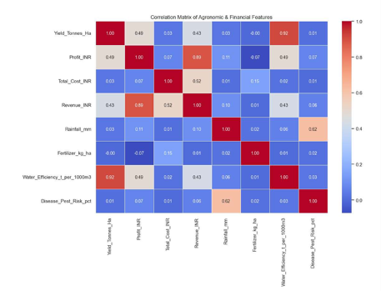
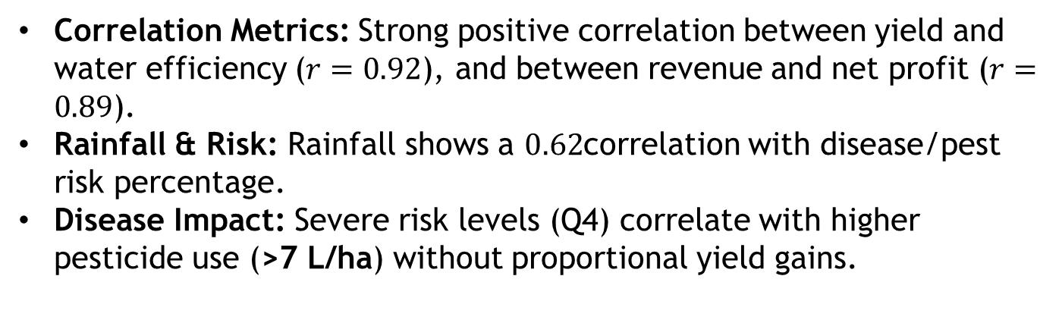
RESULTS
4. Disease Risk & Feature Correlations
Correlation Metrics: Strong positive correlation between yield and water efficiency ($r=0.92$), and between revenue and net profit ($r=0.89$).
Rainfall & Risk: Rainfall shows a $0.62$correlation with disease/pest risk percentage.
Disease Impact: Severe risk levels (Q4) correlate with higher pesticide use (>7 L/ha) without proportional yield gains.

Slide 10
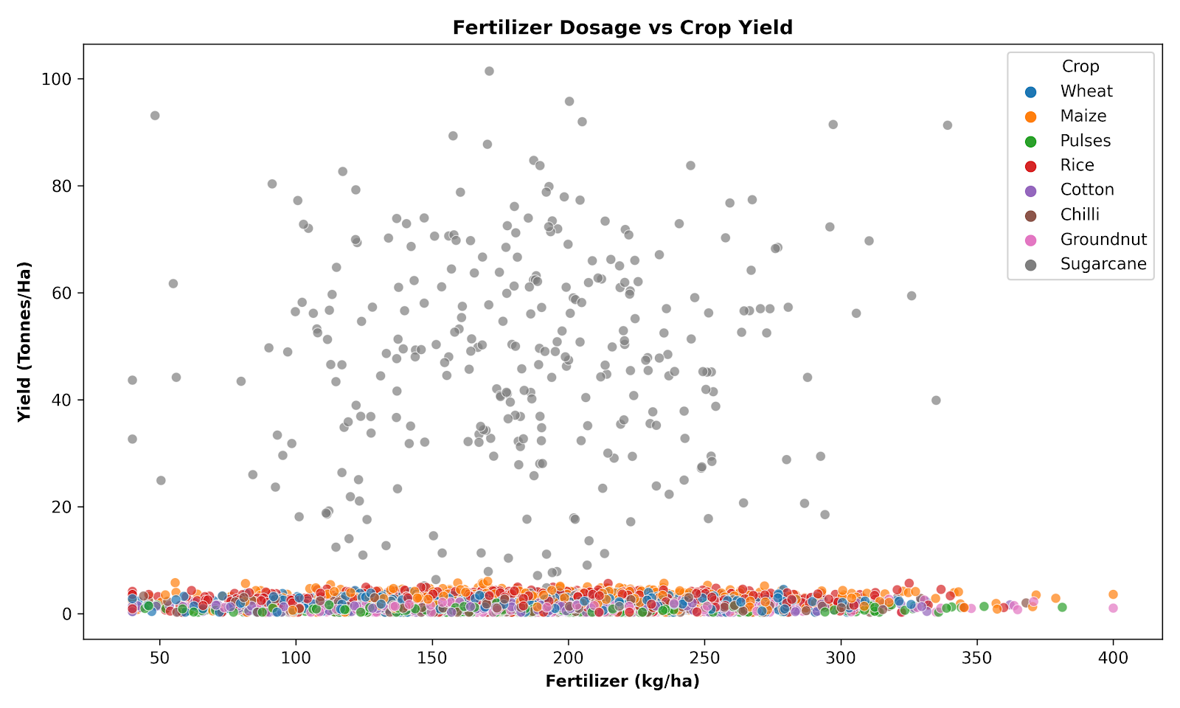
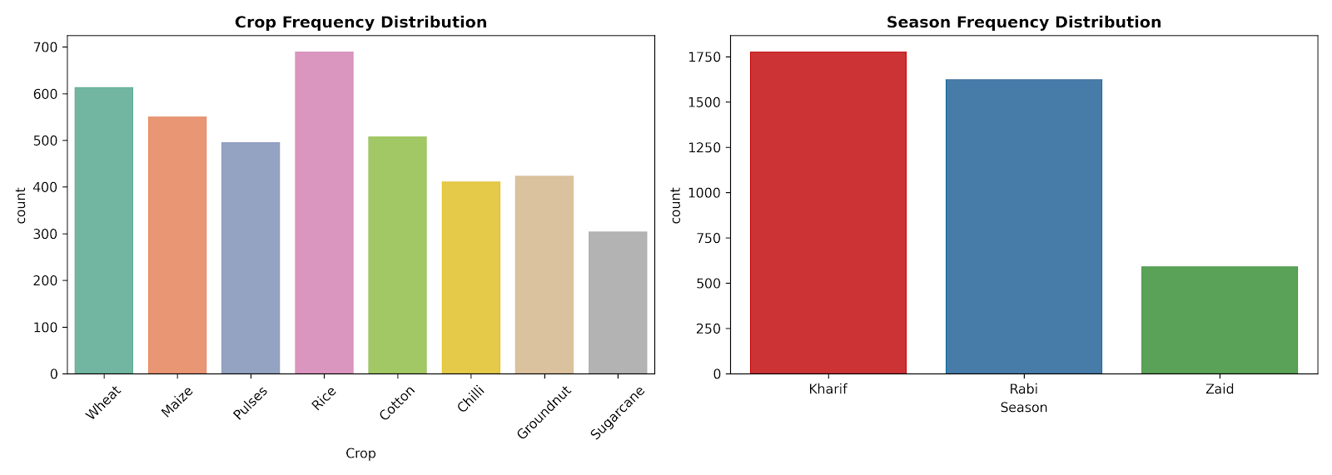
RESULTS
5. Code & Visualization Highlights
Univariate Charts: Crop distribution and season frequency counts.
Scatter Plot: Fertilizer dosage vs. crop yield across crop types.
Heatmap: Correlation matrix of agronomic and financial features.
Bar Chart: Mean profitability by irrigation method across Kharif, Rabi, and Zaid seasons.

Slide 11
Future scope
Predictive Machine Learning: Train machine learning models (e.g., Random Forest, XGBoost) for real-time yield prediction and profit forecasting.
IoT Sensor Integration: Incorporate live soil moisture and weather telemetry to automate drip irrigation delivery.
Web Dashboard: Build an interactive Streamlit or Dash application to support real-time crop planning and scenario testing.
Market Integration: Connect live wholesale price feeds to advise farmers on crop selection based on market conditions

Slide 12
GitHub Link
https://github.com/Awazali123/Seasonal_Agriculture_Performance_Yield_Optimizatio_Analysis

Slide 13

VOIS Course completion certificate -
Course name- Data Visualization

Slide 14
Thank you
.
.

